Slide 1
Senior Design Project Summary Slide
Jesse Dengel (jad6nc@umsystem.edu)
Justin Chau (jc2w4@umsystem.edu)
Matt Mutarelli (Mnmxcd@umsystem.edu)

Slide 2
Introduction - DAQ
DAQ – Data Acquisition System
Measure physical signals and convert them into digital signals to view
Oscilloscope – DAQ for specifically voltage signals
Problems with current DAQs
Expensive
Difficult to maintenance
Closed system that is hard to observe
Notes:
Matt

Slide 3
COVID-19 Response Plan
COVID-19 shifts project from physical implementation to simulation demonstration tested for multiple different cases.
Two or three weeks spent on adjusting project
Most purchased physical components purchased became obsolete for the project demonstration
Analog section was simulated using TI TINA
All team member are familiar with TI TINA software
TINA comes with built in spice models for TI ICs
Notes:
Matt

Slide 4
COVID-19 Response Plan
Remove objectives for physical implementation and PCB design
PCB designs of implementation complete, but not used
Physical component are obsolete, but the restrictions of the components were implemented in simulation
System Voltage from power supply
Signal conditioning
Microcontroller conditioning
Notes:
Matt

Slide 5
COVID-19 Response Plan
New objectives to convert analog system to circuit simulation
Develop TINA circuits for all designed circuits
Verify the operation of all TINA circuits through simulation
Link TINA circuits to create simulation flow
Export/import to transfer signals between circuits
Excel Macro developed to format data for import
Establish communication protocol to export data in TINA to be read in LABVIEW
Develop demonstration videos of the DAQ system
Notes:
Matt

Slide 6
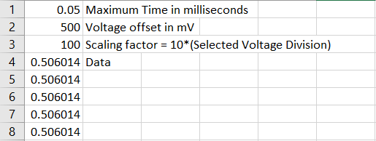
Communication Protocol
Developed and agreed upon by the analog section and the digital section to communicate the signal in the analog section to the digital section.
The signal from the analog section in TINA was exported and read by the digital system as a CSV. The first three lines contained system information about the signal and the remaining lines contained data.
Notes:
Matt

Slide 7



Analog Specifications
System Voltage: $±12V$ based on purchased power supply
Maximum Frequency: $1MHz$
Composed of multiple simple individual TINA circuit files
Easier to comprehend each circuit in the system
Reduced simulation time
4 Analog Input Probes: $±50V$
3 Voltage Division Options: 1:5, 1:10, 1:20
Operates on 2 selected probes: Channel 1 and Channel 2
Channel 1 is the primary probe
Channel 2 is the auxiliary probe
4 Digital Input Probes: $±50V$
Regulates Voltage to logic voltages
Logic 1: 3.3V
Logic 0: 0V
Notes:
Matt

Slide 8

Analog Components
Linear Power Supply HBB15 – 1.5 - AG
System Voltage $±12V$ DC with small ripple
Maximum current: 1.7A
Maximum Power : 40W
Operational Amplifier: LM318
Used for all operational amplifier circuits
Texas Instruments IC included in TINA
Bandwidth: 15 MHz
Analog Multiplexer: DG408
8:1 Analog multiplexer used for selecting signals
Break before make switching
Switch time: <250ns
Notes:
Matt

Slide 9

Analog Section Design Changes
Analog Input voltage Changed
Analog Input voltage changed from $±100V$ to $±50V$
Reduced to match system voltage limits with 1:5 Probe
Alternative was to increase system voltage with new power supply
FFT Equalizer Operation Removed
The operation was designed to split the signal into multiple frequency bands to observe the different frequency components of a signal. The gain of the different bands could be changed to increase certain frequencies while attenuating other frequencies.
The equalizer operation was removed due to time constraints due to the change in the project design and COVID-19.
The aspects of the equalizer design were implemented in the differentiation and integration equalizers.
Notes:
Matt

Slide 10

Analog Section Design Changes
Single wide band integrator and differentiator replaced with integration and differentiation equalizer
The frequency range from $1 Hz$ to $1 MHz$ was six decades. Using one low pass filter and one high pass filter will cause extreme attenuation.
A system of six low pass and high pass filters that each operated on one decade of the frequency range to limit attenuation.
Equalizer design based on removed FFT equalizer operation.
Notes:
Matt

Slide 11
Limitations of Circuit Simulation Design
Limited communication between different analog components
No communication about what voltage division was selected
The only communication between files was through imported/exported signals
Limited communication between analog section and digital section
The digital section could not control the different control switches in the analog section.
The only communication between systems was through the CSV file.
Notes:
Matt

Slide 12
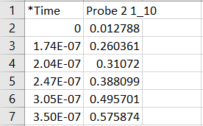
Limitations of Circuit Simulation Design
Analog sampling was based on TINA simulation
The digital section could not control the sampling of the signal in the analog section.
TINA simulations did not generate points using a constant sampling time.
The DAQ system assumed a constant sampling time, so the display may appeared stretched or compressed.
Notes:
Matt

Slide 13
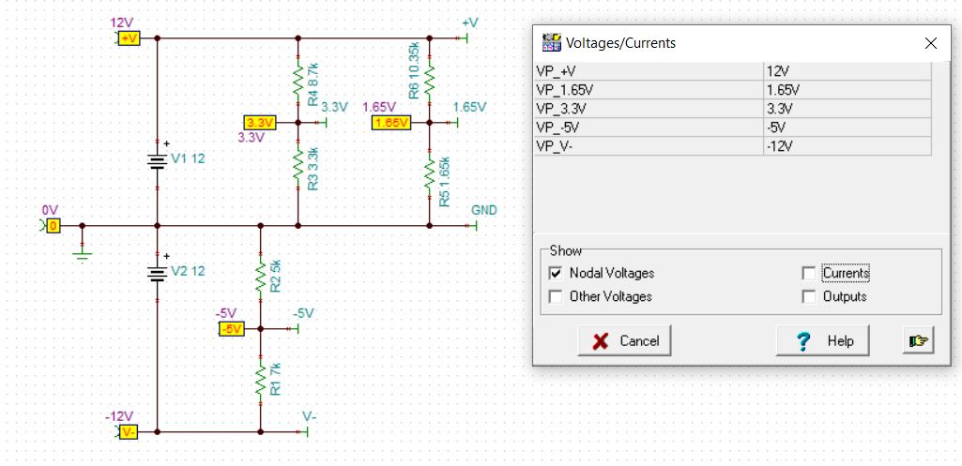
Power Supply Circuit
Notes:
Matt

Slide 14
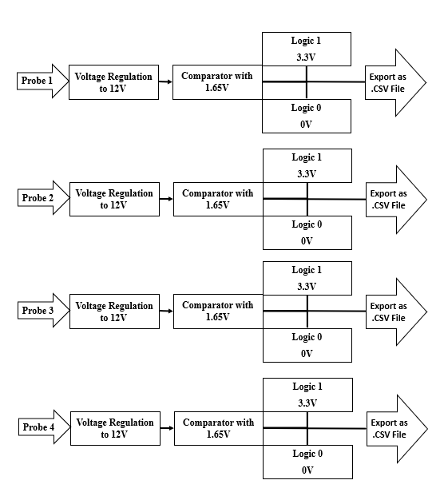
Block Diagram Digital Inputs
Notes:
Matt

Slide 15
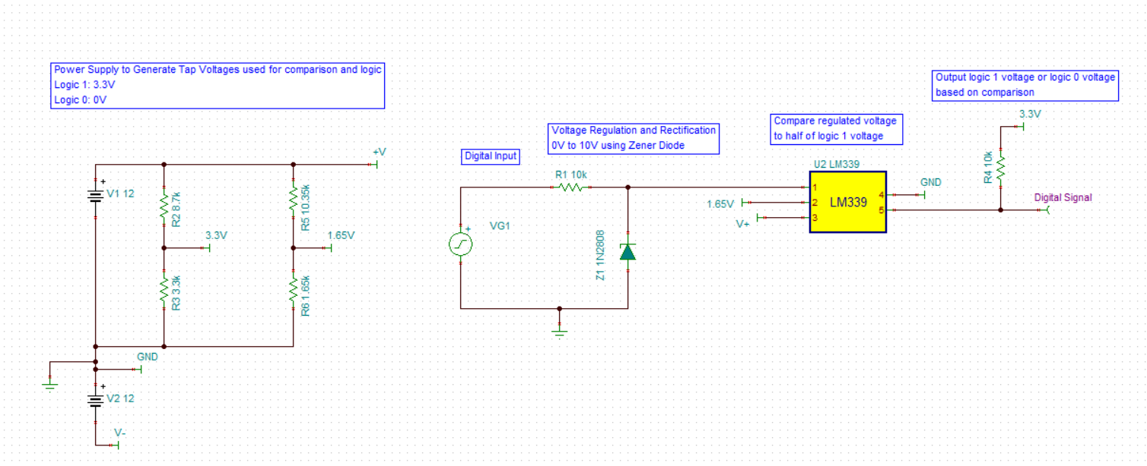
Digital Input Circuit
Notes:
Matt

Slide 16
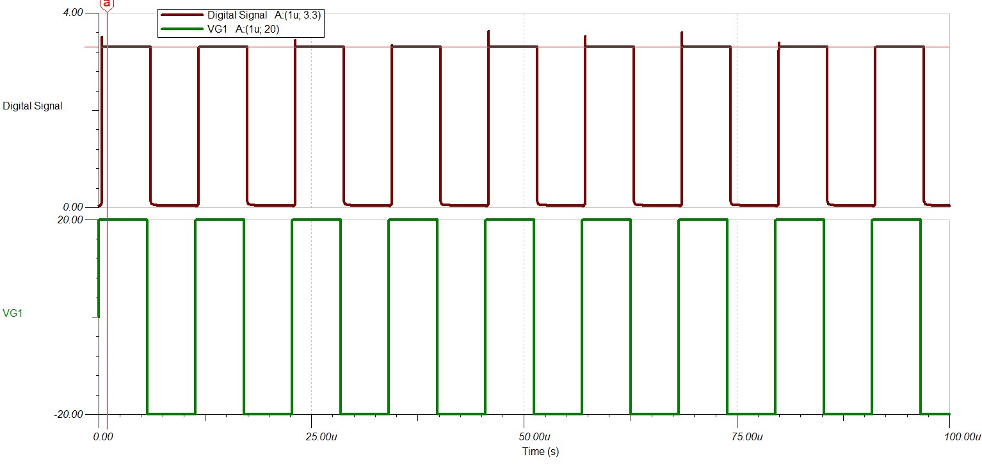
Digital Input Simulation
Notes:
Matt

Slide 17
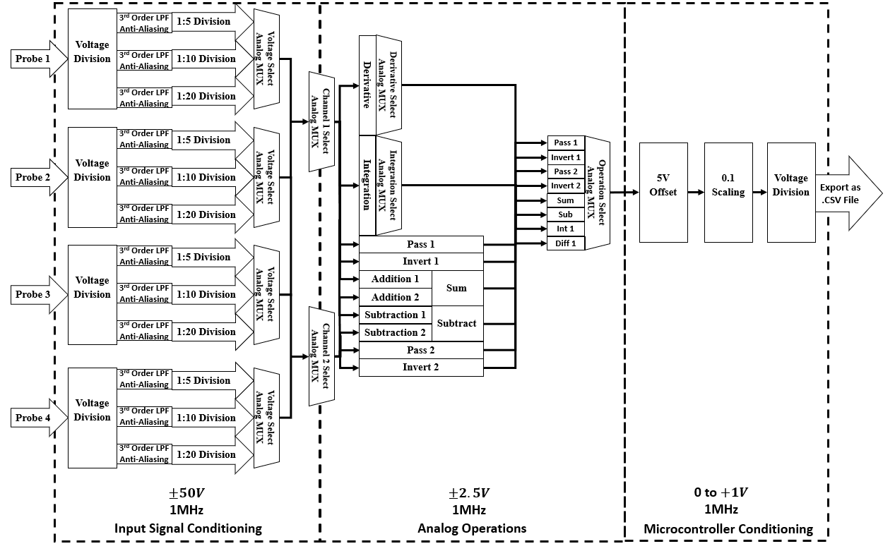
Block Diagram – Analog Inputs
Notes:
Matt

Slide 18
Testing Process
Types of Waves
Sine
Triangle
Voltage Levels
10
20
50
Frequencies
1 kHz
10 kHz
253 kHz
Operations
Pass
Invert
Addition
Subtraction
Differentiation
Integration
DC

Slide 19
Requirements
Tina
Adds data points
Exports multiple outputs in one file
Only reads tab delimited
Microcontroller
Only reads comma delimited .CSV

Slide 20
Solutions
Macros
Separate data points
Separate data points & reduce by an order of magnitude
Add & remove necessary information for the microcontroller to use
Manual
Save as tab delimited
Save as comma delimited .CSV
Importing & Exporting

Slide 21
The Process
Create or import signal
Run the simulation
Export as text
Import to Excel
Run required macro
Save results as correct file type
Import to Tina

Slide 22
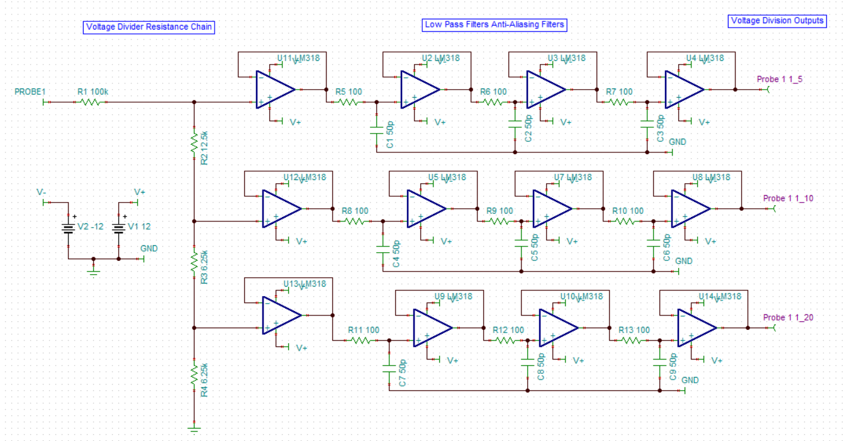
Analog Input Circuit
Notes:
Matt

Slide 23
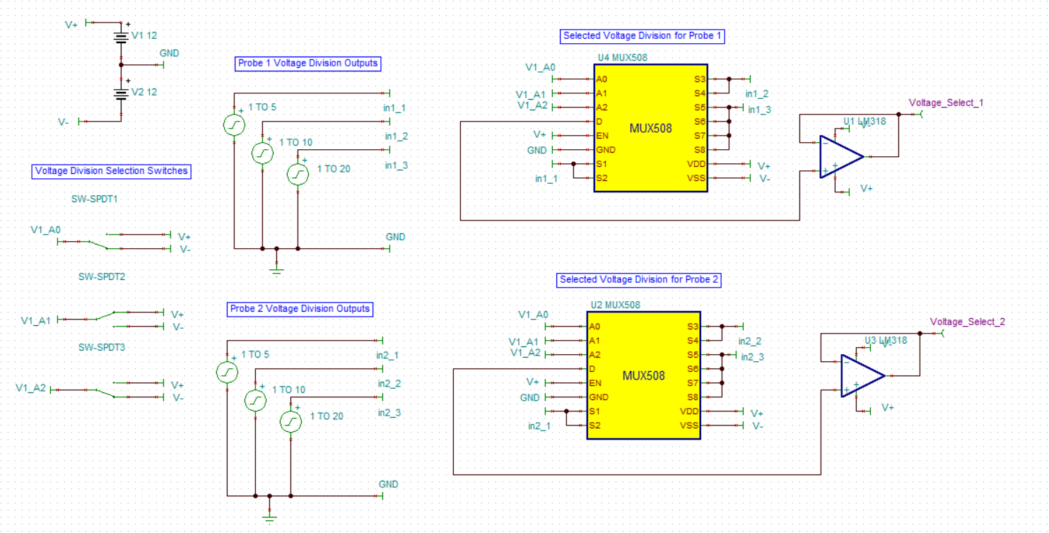
Voltage Select Circuit
Notes:
Matt

Slide 24
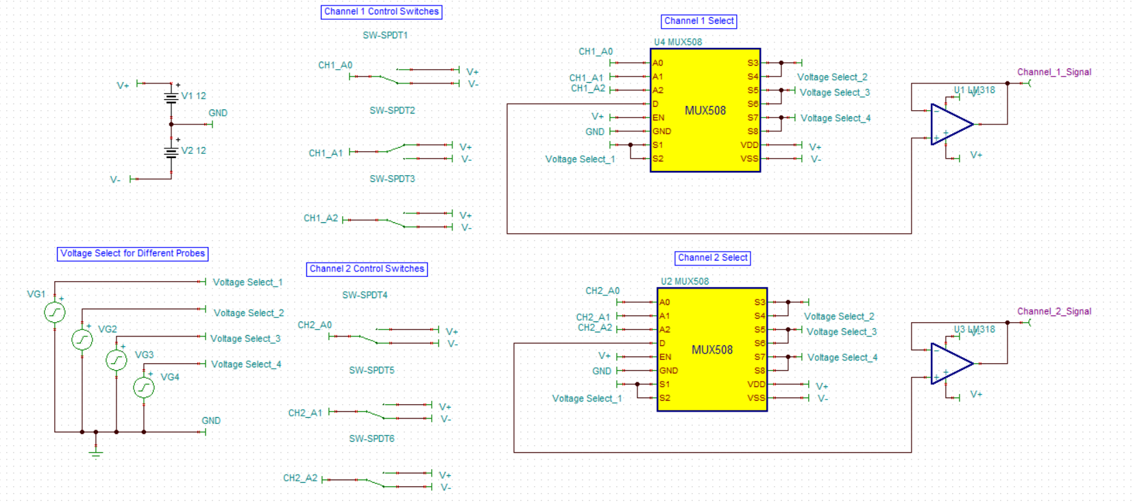
Channel Select Circuit
Notes:
Matt

Slide 25
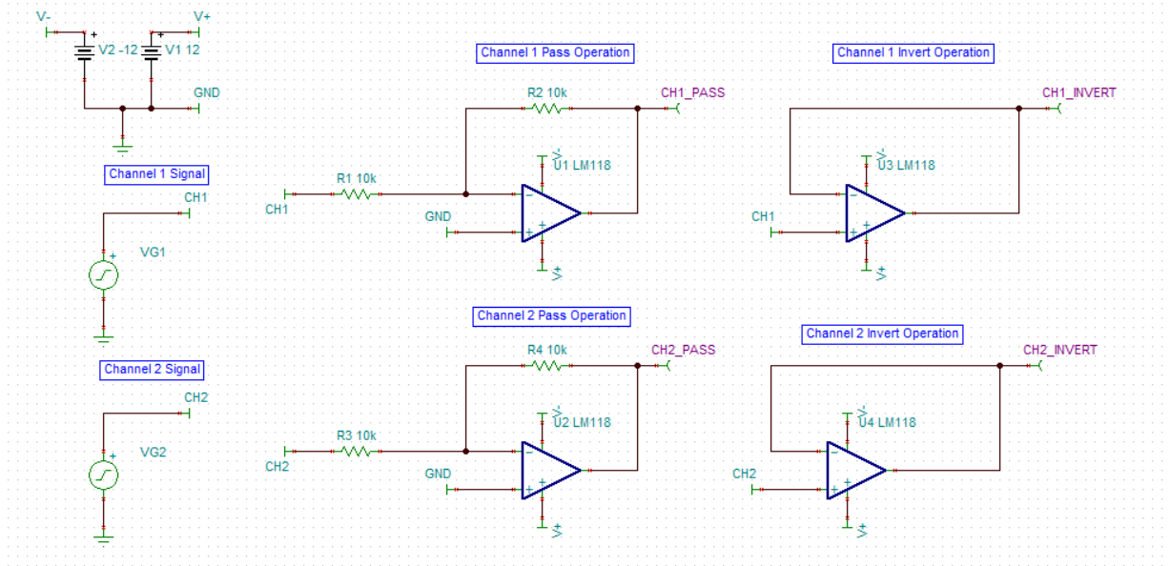
Pass and Invert Operations
Notes:
Matt

Slide 26
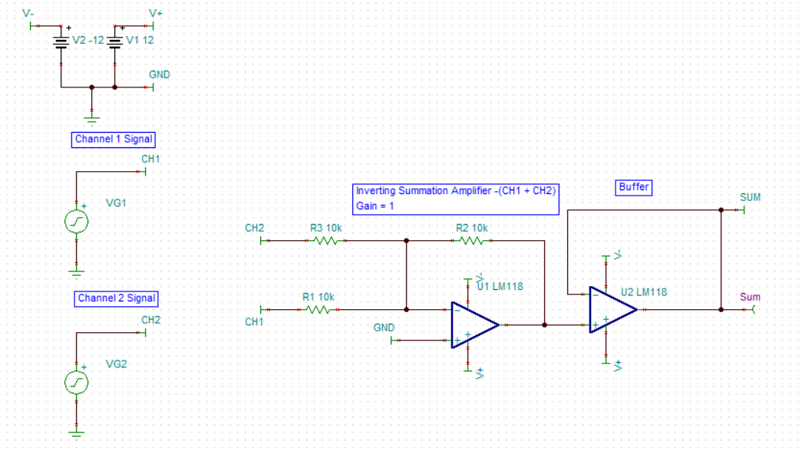
Addition Circuit
Notes:
Matt

Slide 27
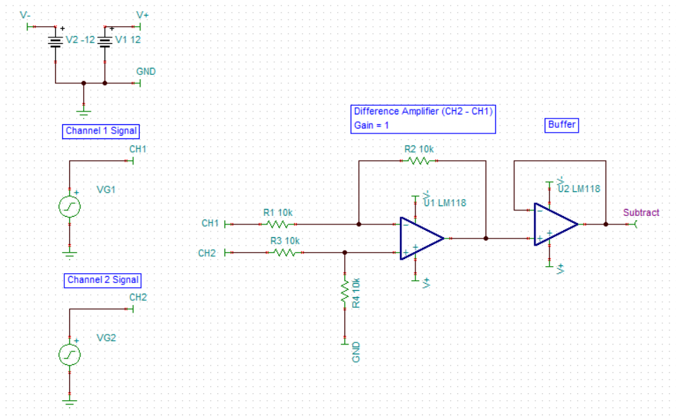
Subtract Circuit
Notes:
Matt

Slide 28
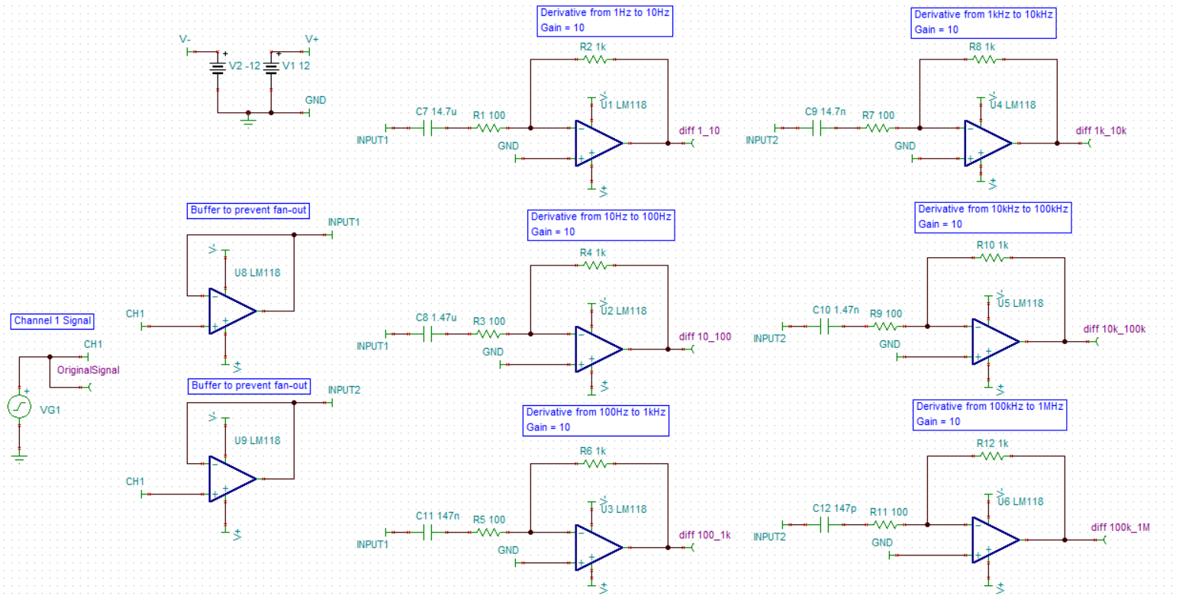
Differentiation Circuit
Notes:
Matt

Slide 29
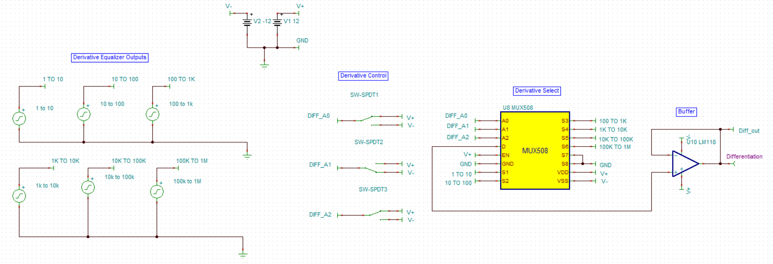
Differentiation Select Circuit
Notes:
Matt

Slide 30
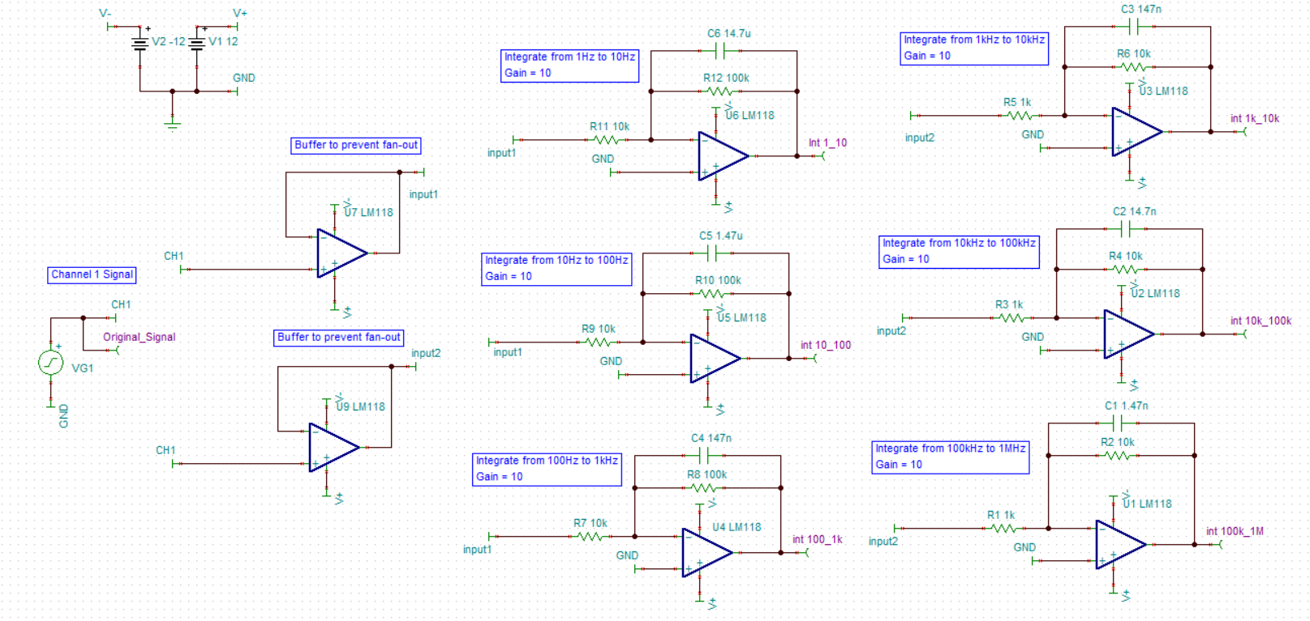
Integration Circuit
Notes:
Matt

Slide 31
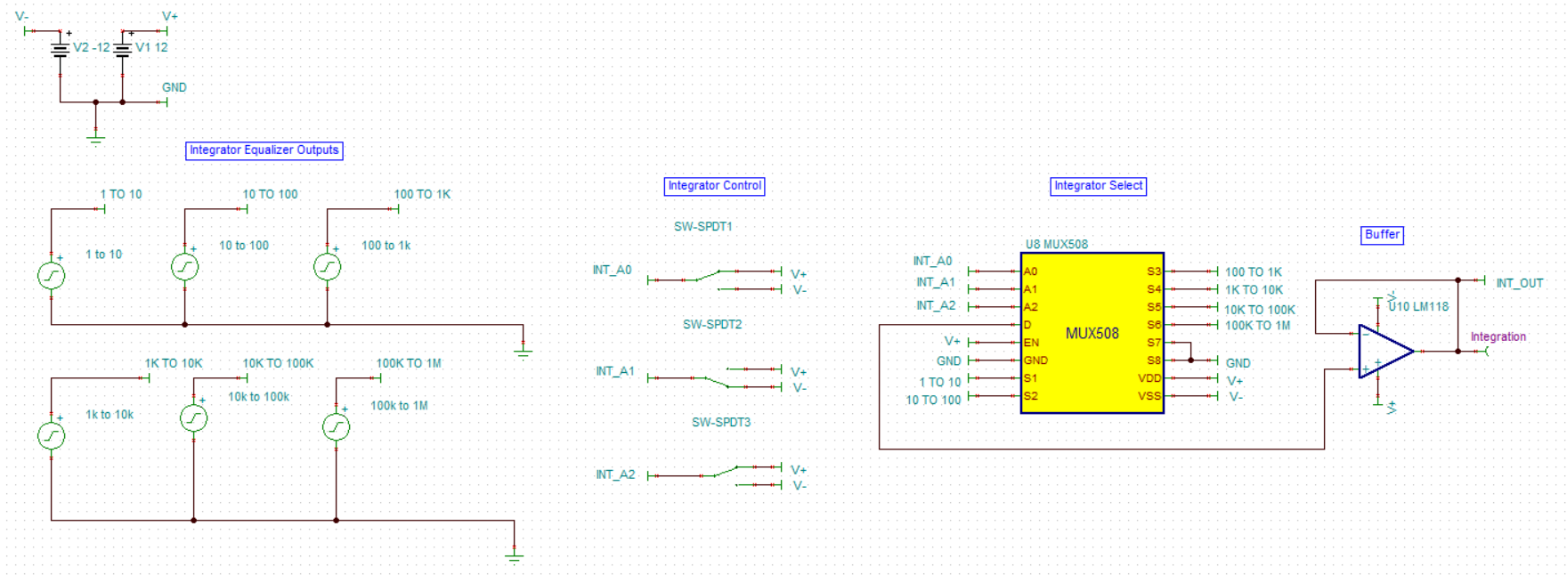
Integration Select Circuit
Notes:
Matt

Slide 32
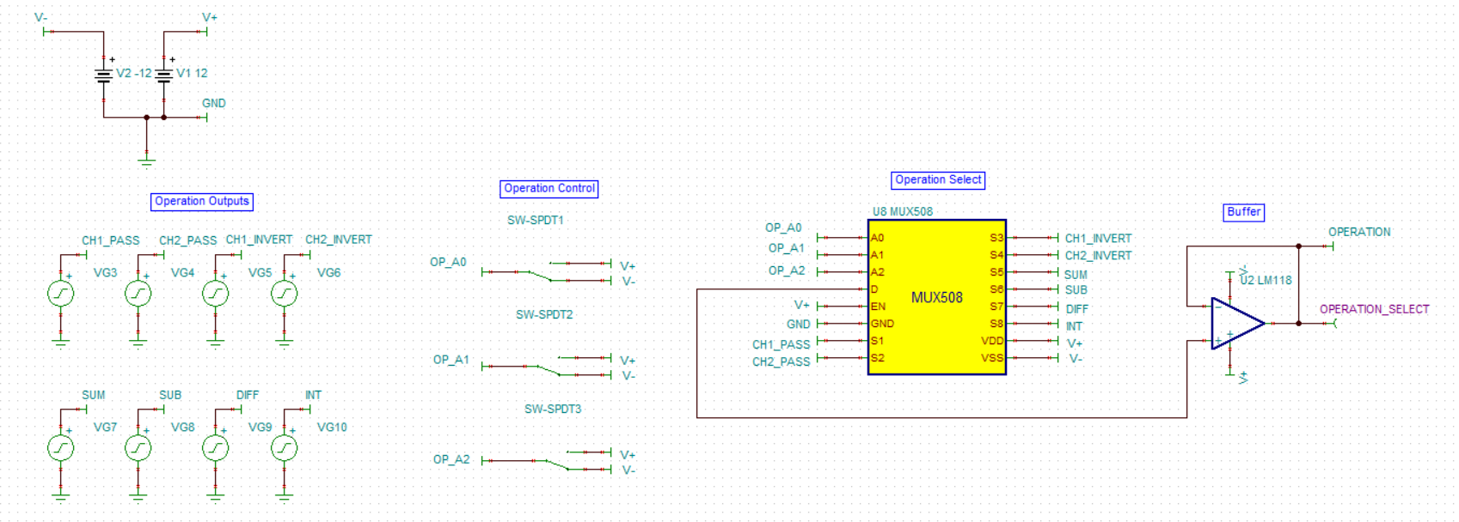
Operation Select Circuit
Notes:
Matt

Slide 33
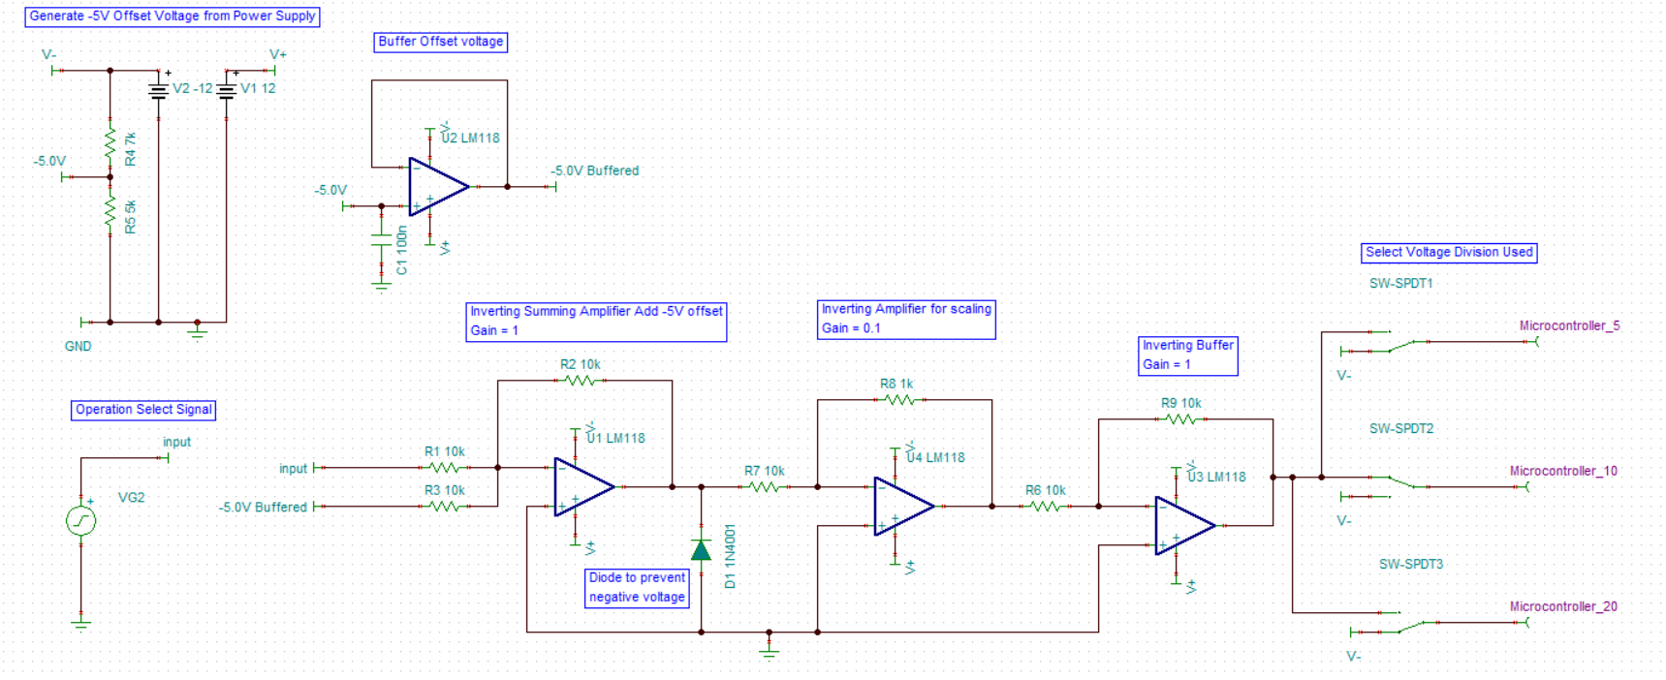
Microcontroller Conditioning Circuit
Notes:
Matt

Slide 34
SPECIFICATIONS - DIGITAL OPERATIONS
NI 6501
Uses LabVIEW to do all interactions with microcontroller
Digital Addition, Subtraction, Integration, Differentiation
Output Digital Data serially through USB
Uses NI-6501 due to COVID-19 causing restrictions on parts that are able to be ordered.
13 bit ADC at 48K samples per second
Notes:
Jesse

Slide 35
SPECIFICATIONS - DIGITAL OPERATIONS
Display Software
Use LabVIEW to receive digital data serially as a CSV data stream
Use LabVIEW to create a front panel to display results
Notes:
Jesse

Slide 36
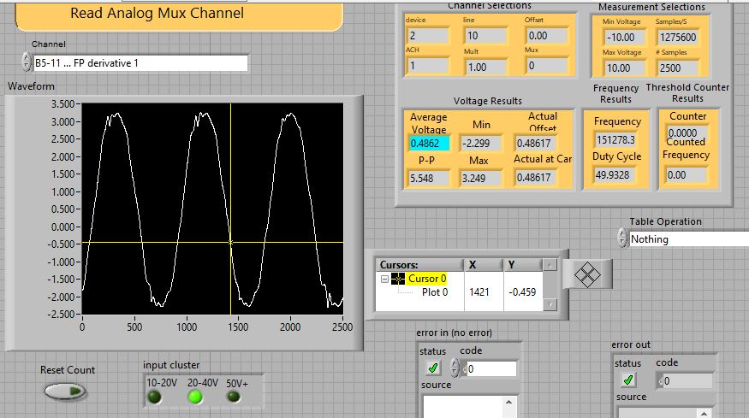
DIGITAL OPERATIONS
Notes:
Jesse

Slide 37
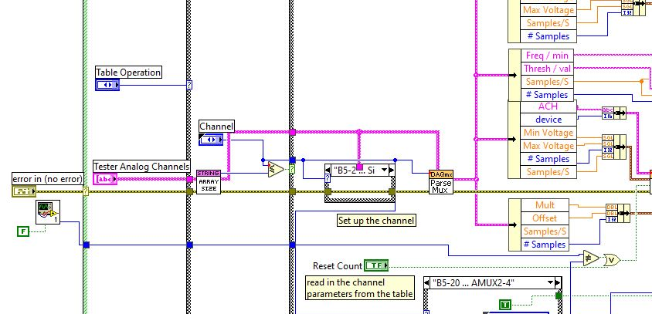
SPECIFICATIONS - DIGITAL OPERATIONS
Display Software Front Panel Code
Notes:
Jesse

Slide 38
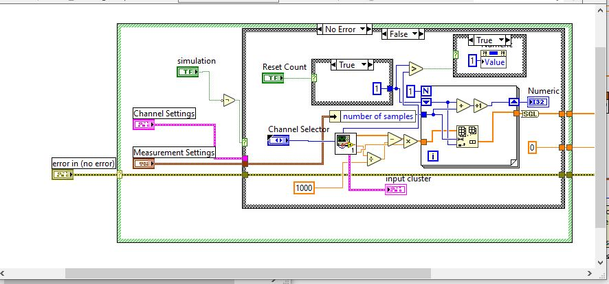
SPECIFICATIONS - DIGITAL OPERATIONS
Read CSVs and convert to an array for dislpay
Notes:
Jesse

Slide 39
Digital Operations: User Interface
Uses LabView as a basic end user interface
Installation package to works on any computer Windows 7 or above.
Ability to scale voltage and time, software performs automatically
NI-6501 can read up to 24 different channels, some channels have the option to be used as a DAC
User or calling software can select any channel to take predefined samples of channel

Slide 40
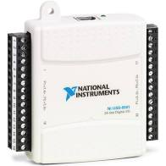
SPECIFICATIONS - DIGITAL OPERATIONS
NI-6501
Max sampling rate
48,000 Samples
per second
Notes:
Jesse

Slide 41
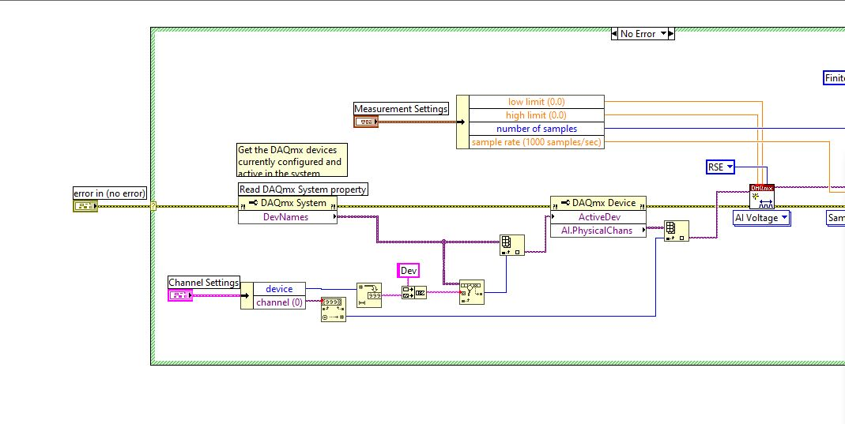
SPECIFICATIONS - DIGITAL OPERATIONS
LabView DAQmx - Acquire Waveform
Notes:
Jesse

